Slide 1


Slide 2
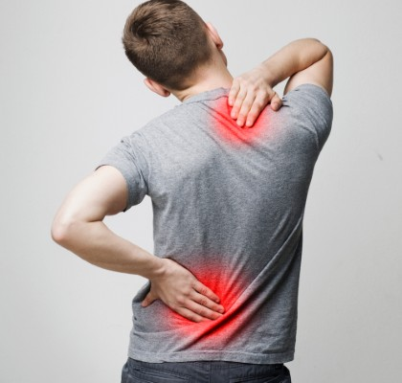
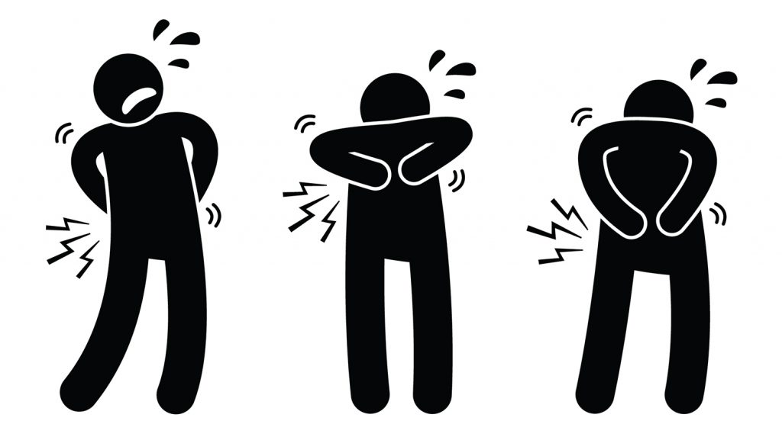
PAIN

Slide 3
UNIT 10 : Pain
PREPARED BY:
MUSKAN PRADHAN
ROLL NO:15
BNS 2ND YEAR,17TH BATCH
TU,IOM

Slide 4
General objective
At the end of this classroom session, BNS 1st year students will be able to explain about types of pain and its physiology.

Slide 5
Specific objective
At the end of this classroom session, BNS 1st year students will be able to:
introduce pain.
explain about the types of pain.
explain the physiology of pain process.

Slide 6
PAIN
The word pain derived from Greek word' poine 'and French word' peine 'all means PUNISHMENT . Pain is highly unpleasant and very personal sensation that people perceive in different ways.
Pain is highly unpleasant and very personal sensation that cannot be shared with others. It can occupy all of a person's thinking, direct all activities and change a person life.

Slide 7
Pain is " unpleasant sensory and emotional experience associated with actual or potential tissue damage or described in term of such damage."(Merskey and Bogduk,1994)
"Pain is whatever the experiencing person says it is existing whatever he says it does." (Margo Mc.Caffery.1979)

Slide 8
Pain is more than a symptoms of a problem, or it a high priority problem in itself. It prevents both physiologic and psychological danger to health and recovery.
Pain occurs as the result of many disorders, diagnostic tests, and treatments; it disables and distresses more people than an single disease.

Slide 9
Because nurses spend more time with patients in pain than other health care providers do in a variety of settings, including acute care, outpatient and long term care settings as wall as the home. Therefore, nurses need to have knowledge and skills to assess pain ,understand the pathophysiology of pain, physiological and psychological consequences of acute and chronic pain, and the method used to treat pain.

Slide 10
Our individual pain perception can vary at different times, even in response to the identical stimulus. For example, an athletes during competition may not be able to feel the tissue injury of a cut or a bruise until the competition has finished. We may feel more or less pain depending on our mood, sleep pattern, hunger or activity.

Slide 11
Nature of the Pain
Pain is subjective and highly individualized.
The pain experience is complex, involving physical, emotional and cognitive components.
Pain interferes with personal relationship and influences the meaning of life.
Cannot be objectively measured.

Slide 12
TYPES OF PAIN
Pain is classified in various ways. It can be classified according to its duration, location, and etiology. The basic categories of pain are generally recognized acute pain, chronic pain and cancer related pain.

Slide 13
Based on duration and intensity
Acute pain
It is an episode of the pain that last from split of second to 6 months. The major features are :
Protective
Has identifiable cause
Has limited tissue damage and emotional response

Slide 14
Eventually resolves with or without treatment after healing of damaged area.
Unrelieved acute pain can progress to chronic, so need an management.
Acute pain causes vital signs changes, diaphoresis, anxiety
Example: fracture pain, headache in meningitis etc.

Slide 15
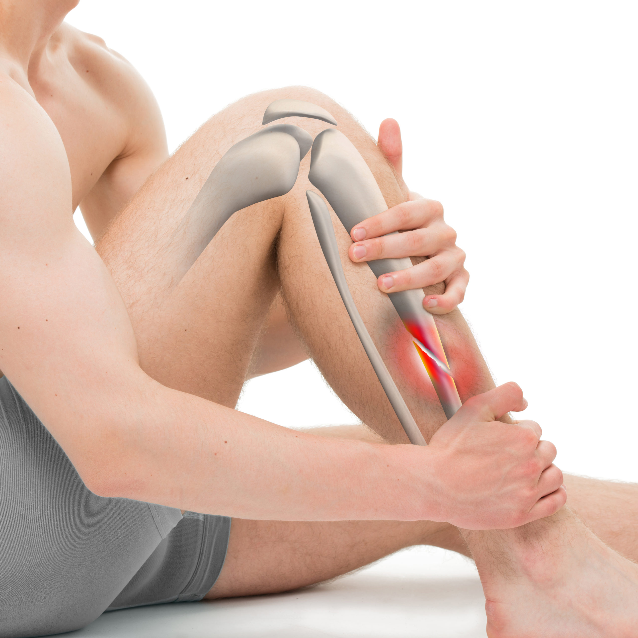

Slide 16
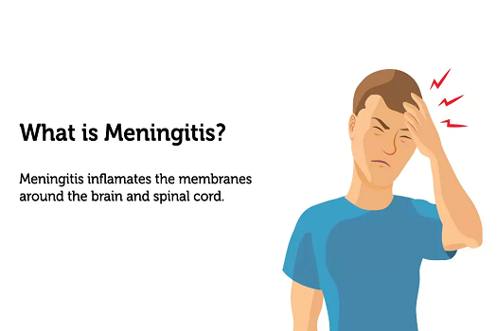

Slide 17
Chronic pain
An episode of pain that lasts for 6 months or longer is chronic pain. The major features are:
Not protective
Causes fatigue, depression, immobility, anorexia, weight loss , anger.
Chronic pain creates both physical and psychological problems that affects whether person can engage into meaningful activities each days.

Slide 18
Pain can decrease persons strength, coordination and independence in addition to causing stress that may lead to depression.
Examples: low back pain, joint pain, nerve pain, migraine headache etc.

Slide 19
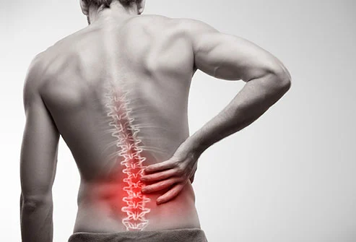

Slide 20
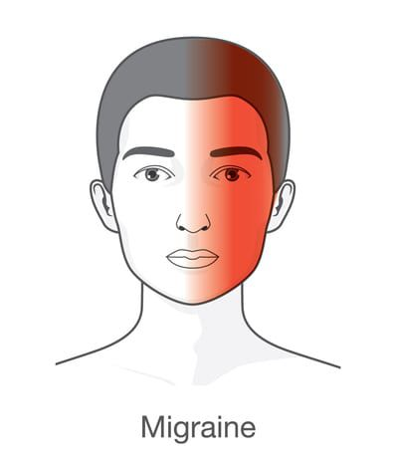

Slide 21
2.On the basis of origin
Cutaneous pain
It originates in the skin or subcutaneous tissue.
It can have a fast or slow onset.
E.g cut causing a sharp, bright, burning pain.

Slide 22


Slide 23
Deep Somatic Pain
Steams from ligaments, tendons, muscles, joints, periosteum, and blood vessels .
It is diffuse and tends to last longer than cutaneous pain

Slide 24
Visceral Pain
Originates from viscera (the abdominal organ) or the organs of the other body cavity, internal organ; diffused at the 1st and later may be localized .
E.g. appendicitis.
Psychogenic Pain
Individual feels pain but cause is emotional rather than physical.
E.g. stomach ache

Slide 25
3.According to body area of experience
Radiating Pain
Perceived at the source of the pain and extends to nearby tissues.
E.g cardiac pain
Intractable Pain
Severe, constant pain that is highly resistant to relief.
Cannot be controlled with standard medical care.
E.g pain from advanced malignancy.

Slide 26


Slide 27
Referred pain
Pain felt in a part of the body other than its actual source.
E.g. in MI, pain felt in the neck, shoulders and back rather than in the chest.
Phantom pain
Painful sensation perceived in a body part that is missing.
E.g. an amputed leg.

Slide 28
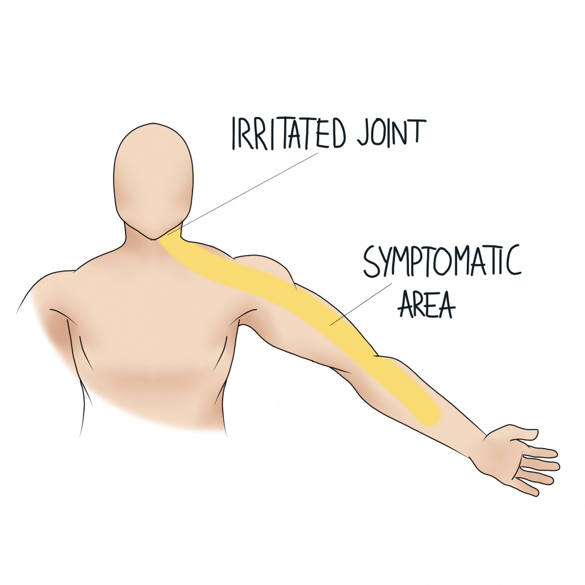

Slide 30
Neuropathic pain
It is the type of pain results from damaged to the peripheral or CNS or pathological changes in neurofunctional relationship within the PNS/CNS.
It is long lasting, unpleasant and can be described as a burning dull and aching episodes of sharp, shoot pain.

Slide 31
May exhibit opioid resistant or requires higher doses to achieve pain relief.
E.g.: Neuralgia

Slide 32


Slide 33
4. According to cause
Cancer pain
Pain associated with cancer may be acute or chronic.
Pain in patients with cancer can be directly associated with the cancer, a result of cancer treatment or not associated with the cancer.
However, most pain associated with cancer is direct result of tumor involvement.

Slide 34
Non cancer pain
Includes surgery or injury, Degenerative disease (e.g. arthritis), Child birth, Nerve compression or injury.
Pain may be acute and last for a limited time or may become chronic.
The cause may or may not be obvious.

Slide 35
PHYSIOLOGY OF PAIN
There are peripheral nerve fibers and their receptor endings that monitor the stimuli for pain.
The spinal cord circuitry that processes pain information, the pathways that project pain information to the brain, the thalamus and cortex that integrate and modulate pain and finally the subjective reaction to pain.

Slide 36
According to Mc. Caffery and Pasero, there are four processes of normal pain:
Transduction
Transmission
Perception
Modulation

Slide 37
Transduction
Pain is usually caused by thermal, mechanical, or chemical stimuli.
The energy of these stimulus is converted in electrical energy.
This energy conversion is known as transduction.
It begins in the periphery when the pain producing stimulus sends an impulse across a peripheral pain nerve fiber, initiating an action potential.

Slide 38
All the cellular damage caused by thermal, mechanical, and chemical stimuli results the release of excitatory neurotransmitters.
Prostaglandins, bradykinin, serotonin, histamine, substance P. These are pain sensitizing substances that surrounds the pain fiber in the ECF.
These substances exert the spread of the pain message and causing an inflammatory response.

Slide 39
Transmission
The pain fiber enter the spinal cord and travels one of the several routes (ventral and dorsal) until pain ending within the gray matter of the spinal cord.
Within the dorsal horn, substance P is released, causing a synaptic transmission from the afferent peripheral nerve to spinothalamic tract nerve.

Slide 40
Pain stimuli continue to travel through nerve fiber in the spinothalamic tract that cross to the opposite side of spinal cord , then travel up the spinal cord.
After the pain impulses ascends the spinal cord, information is transmitted quickly by the reticular formation, limbic system, somatosensory cortex and association cortex.

Slide 41
Perception
Once the pain stimulus reaches the cerebral cortex , the brain interprets the quality of pain and process information from past experience, knowledge and cultural association in the perception of brain.
The somatosensory cortex identifies the location and intensity of pain and the association cortex determines how we feel about the pain.

Slide 42
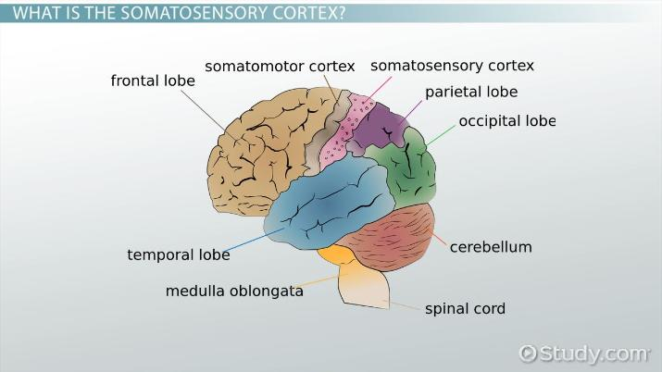

Slide 43
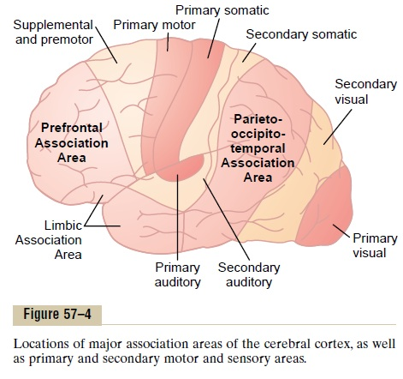

Slide 44
The limbic system processes the emotional reaction to pain. As a person becomes aware of pain, a complex reaction open up.
The reaction to pain is the physiological and behavioral responses.

Slide 45
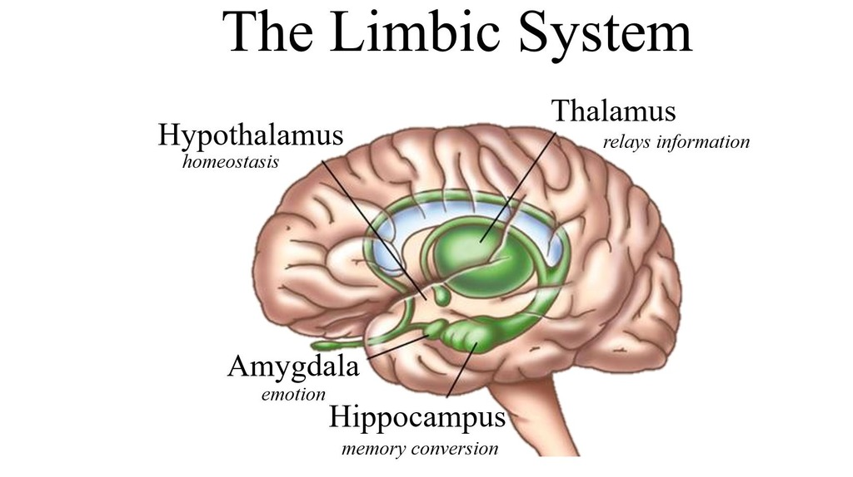

Slide 46
Modulation
Once the brain perceive the pain, there is a release of inhibitory neurotransmitters. Such as endogenous opioids , serotonin, norepinephrine, and gamma aminobutyric acid (GABA).
These work to hinder the transmission of pain and helps produce an analgesic effect.
This inhibition of pain impulses is the fourth phase of the normal process known as modulation.

Slide 47
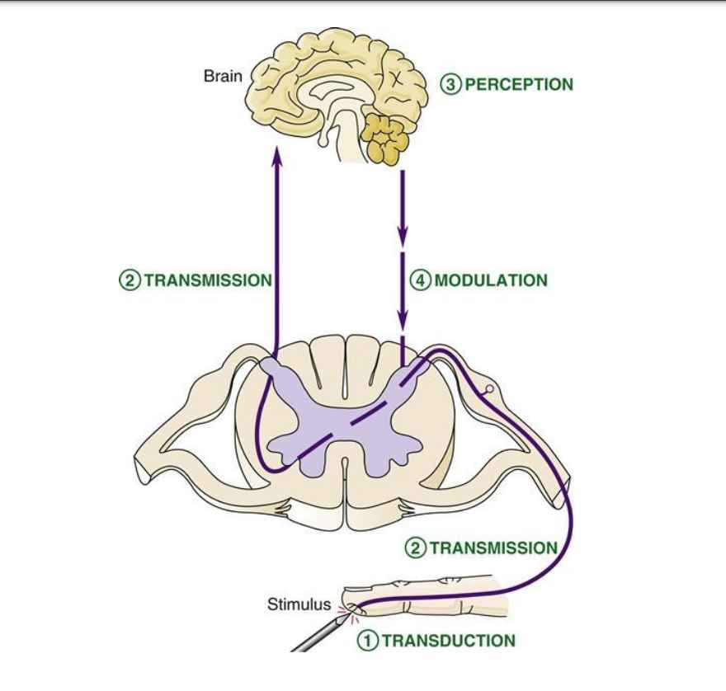

Slide 48
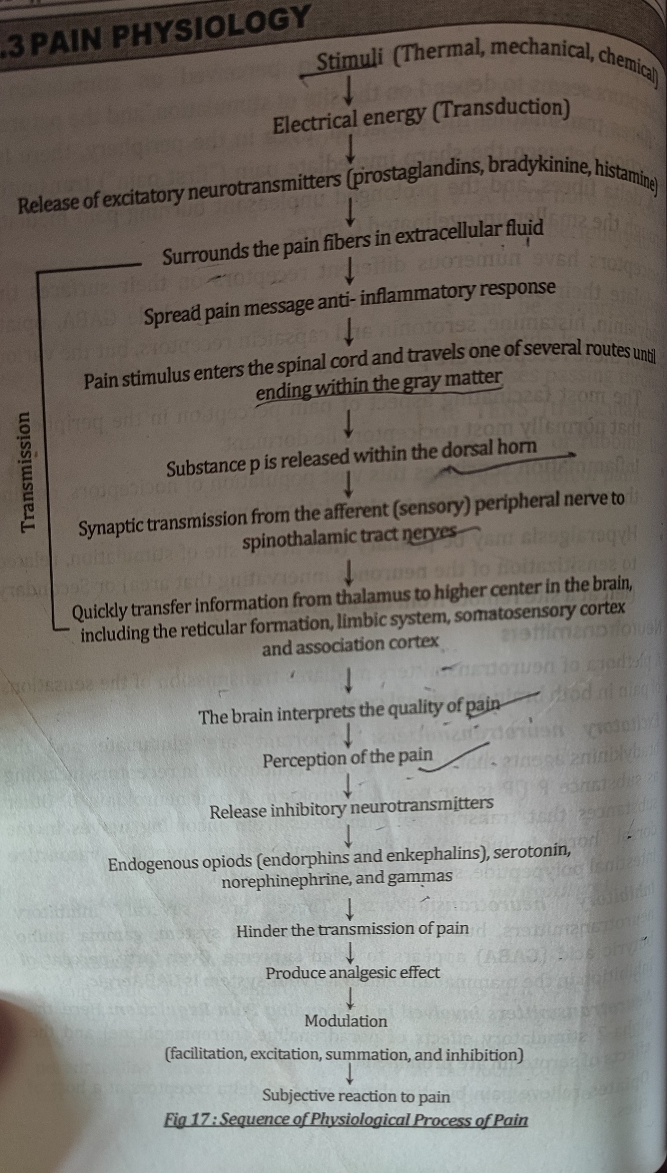

Slide 49
SUMMARY
What do you understand about pain?
List the types of the pain.

Slide 50
HOME ASSIGNMENT
Read about the types of pain and its physiology

Slide 51
PLAN FOR NEXT CLASS
We will discuss about the factor affecting pain perception and response and assessment of pain.

Slide 52
REFERENCE
Acharya K D ,Pokharel D K ,”Nursing Concepts And Principles” 2nd Ed, Jupiter Publishers and Distributor Pvt.Ltd.
Mandal G.N, “Nursing Concept ”, 1st edition,(2005),Makalu books and Stationers, Page no: 495
Rai L, (2015), “Nursing Concepts Theories and Principles”, 3rd Edition, Tara Books and Stationary, Chhatrapati, Kathmandu. Page no: 189-193

Slide 53
S.C Suzanne, B G Brenda, Brunner and Suddarths “Textbook of Medical -surgical Nursing”, 3rd edition ,Wolters Kluwer pvt Ltd.
Sharma M, “Nursing Concepts and Principles” ,2nd Ed, Medhavi publication , Page no: 147-154
https://www.webmd.com/pain-management/guide/pain-types-and-classifications

Slide 54


